Slide 1
Analysis of Hospital Heart Failure Mortality and Readmission Rates by County
Executive Team Presentation
August 13th, 2024
Presented by: Jake Charney

Slide 2
Abstract
Summary: This project aims to uncover variations in heart failure mortality and readmission rates across counties, identifying key demographic and socio-economic contributors to these variations. The analysis utilizes hospital discharge data and applies statistical and machine learning techniques to propose actionable recommendations for optimizing hospital resources and enhancing patient outcomes.

Slide 3
Introduction
Background: Heart failure is a critical public health issue, with significant impacts on healthcare systems worldwide.
Problem Statement: Despite advanced treatments, disparities in heart failure outcomes exist across counties due to varying hospital capabilities and socioeconomic conditions.
Relevance to Stakeholders: Insights from this study are crucial for healthcare administrators and policymakers for more targeted healthcare delivery improvements.

Slide 4
Objectives of the Analysis
Goals:
Identify geographical patterns in mortality and readmission rates.
Investigate factors influencing variability in patient outcomes.
Develop actionable insights to improve healthcare delivery related to heart failure.

Slide 5
Data Collection and Sources
Sources:
Hospital discharge records.
County health rankings.
Demographic databases
Data Content: Information on patient demographics, hospital characteristics, treatment outcomes, and socio-economic factors.

Slide 6
Methodology - Data Preprocessing
Data cleaning and normalization to correct anomalies.
Feature selection based on potential impact on outcomes.
Development of new variables like risk adjustment scores and hospital capacity indices.

Slide 7
Methodology - Analytical Techniques
Techniques Used:
Descriptive Statistics and Correlation Analysis to identify relationships.
Regression Analysis and Geospatial Analysis to quantify impacts and visualize geographic patterns.
Machine Learning (Decision Trees and Random Forests) for predictive modeling and feature importance.

Slide 8
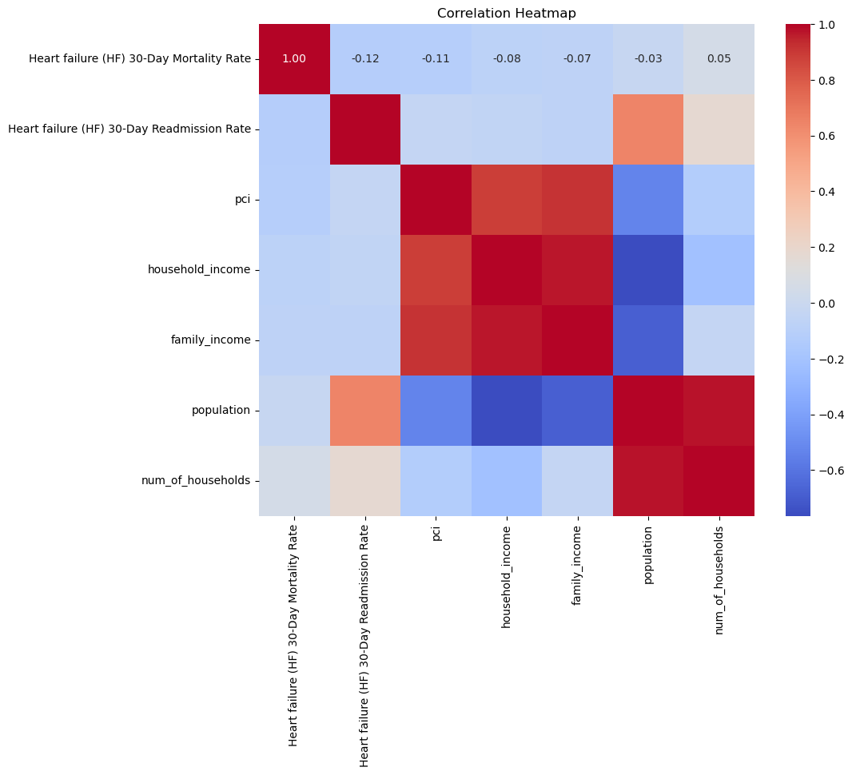
Results - Key Observations
Displayed how various hospital and community factors were interrelated with patient outcomes, providing a visual representation of potential leverage points for intervention.

Slide 9
The implications of these findings were discussed in terms of healthcare policy, resource allocation, and community health initiatives. The analysis clearly indicated that improving hospital facilities and enhancing socioeconomic conditions could lead to better patient outcomes in heart failure cases.

Slide 10
Detailed Analytical Findings
Correlation and Regression Insights: Higher capacity hospitals are associated with better outcomes.
Machine Learning Insights: Key predictors identified include healthcare facilities quality and access to care.

Slide 11
Recommendations & Further Research
Strategic Actions:
Enhance resources in underperforming counties.
Implement targeted training programs for healthcare providers.
Launch community health initiatives focused on prevention and management.
Next Steps:
Conduct longitudinal studies to assess intervention effectiveness.
Expand analysis to include more granular patient-level data.
Explore the impact of technological advancements like telemedicine on outcomes.

Slide 12
Conclusion
The project highlights critical disparities in heart failure management and provides a roadmap for targeted improvements.
Adoption of these recommendations could lead to a more equitable healthcare system and significantly enhanced public health outcomes.

Slide 13
Thanks!
Q & A

